Slide 1
LET’S FIND
Let’s Find our loved one’s.
Notes:
Hi, We are team XDEV from university of agriculture, Faisalabad.

Slide 2
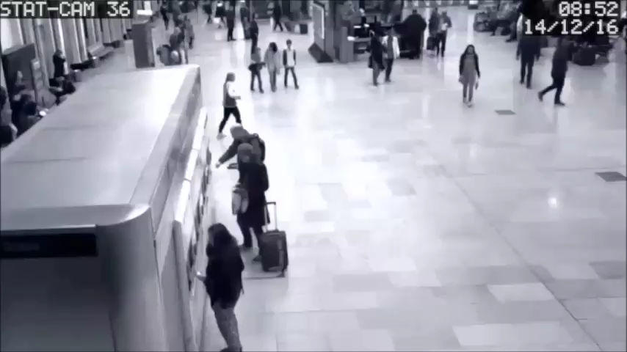
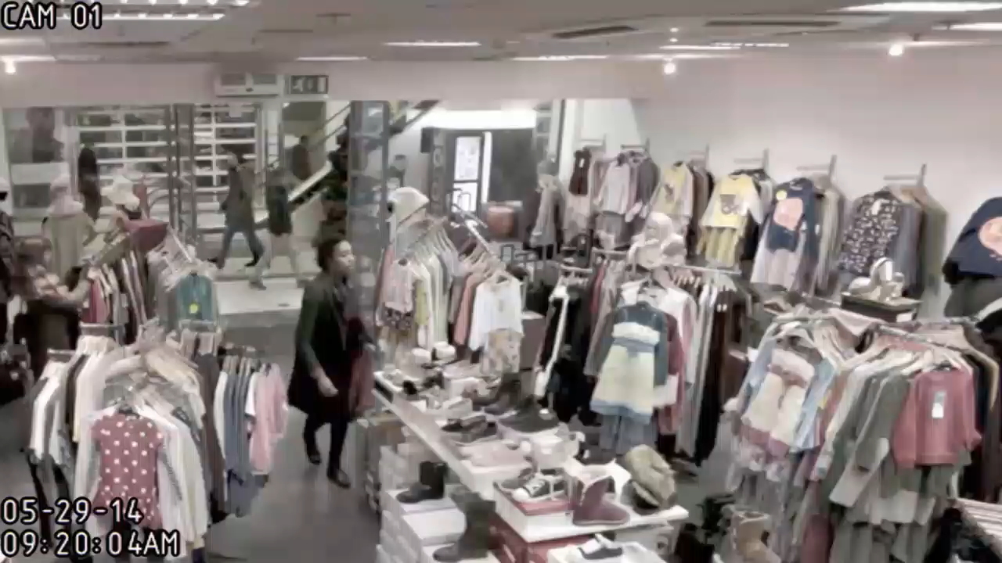
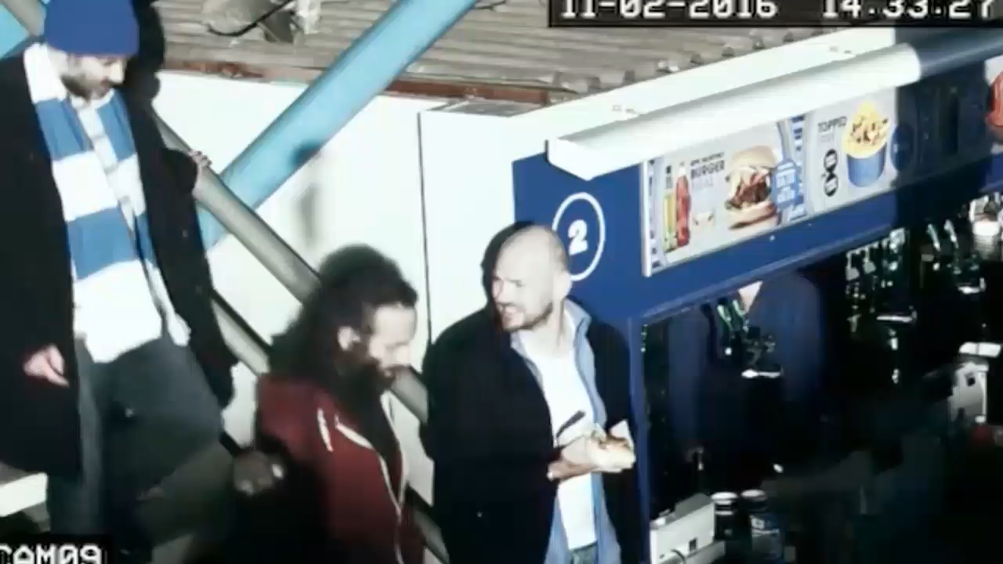
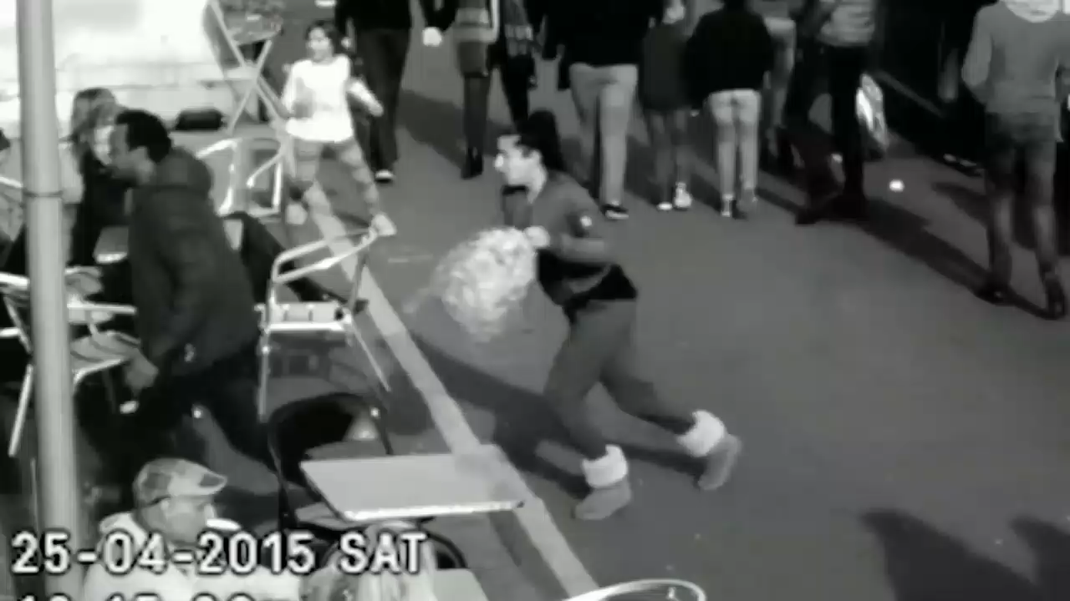
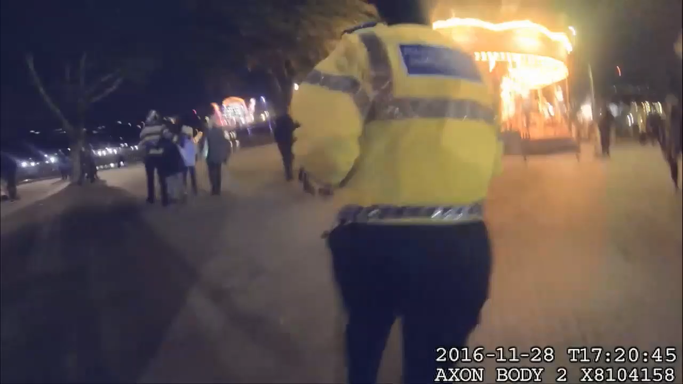
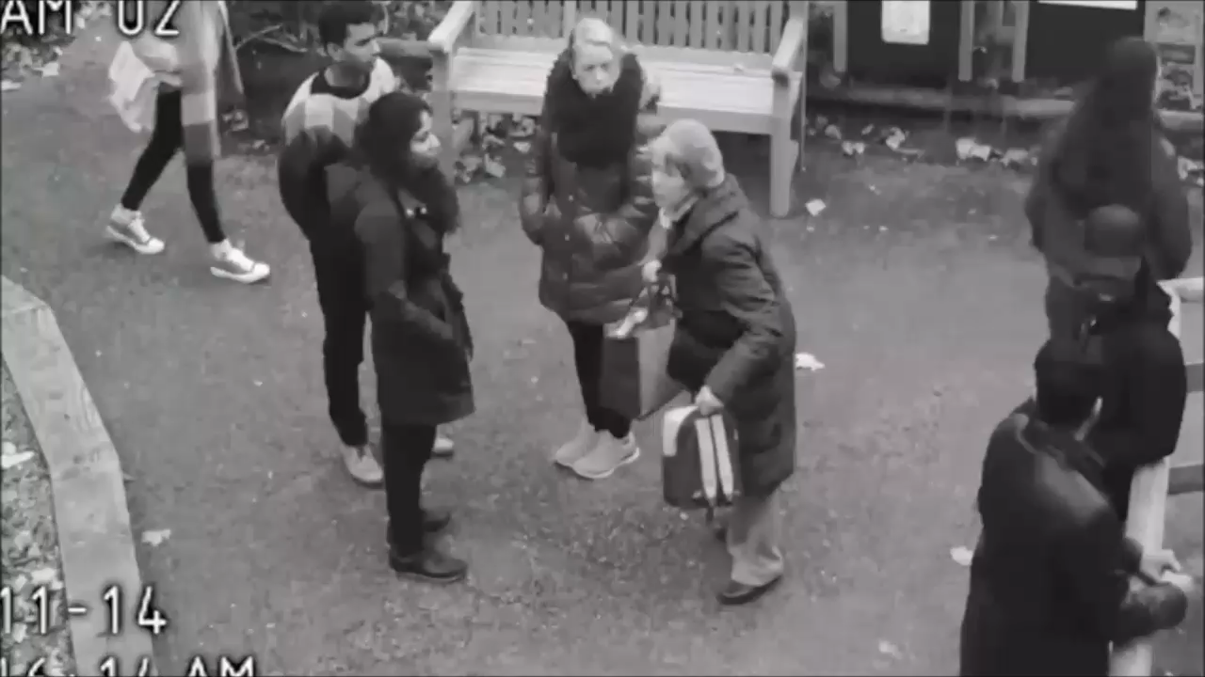
Imagine a Parents worst nightmare.
Notes:
Imagine a parent's worst nightmare,
Imagine the tension,pain and agony they go through if they loose their child.
Thousands of children go missing daily in every part of the world due to a certain reasons like kidnaping and parents negligence

Slide 3
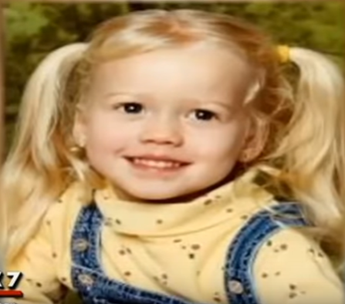

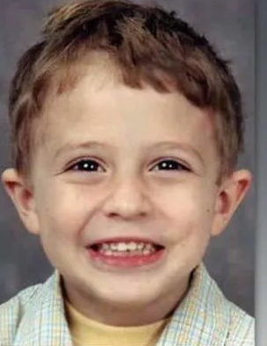
Child Missing Cases
Sabrina Allen
She was lost at the age of 5 years and found after 12 long years when she was 17 years. The nightmare begin when she was lost in 2002 while she went to a party.
Shawn Hornbeck
Julian Hernandez
He didn't realize that he had been missing since 2002. The 18-year-old Alabama boy had been living under false names for more than 13 years.
Kidnapped in 2002 at age 11 while riding his bike near his Missouri home, Shawn Hornbeck was found more than four years later living in a St. Louis apartment.
Notes:
We daily go through a lot of cases either on social media, tv channels, banners or newspapers. like some of these cases where
situation could be worst

Slide 4
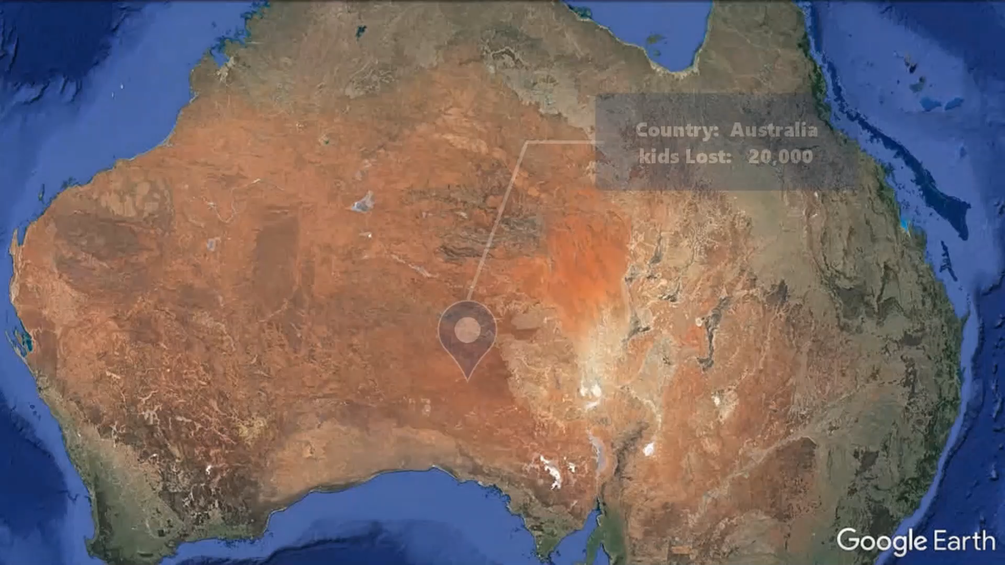
Global Issue
Statics shows that hundreds of thousands of children went missing around the Globe even in the most developed Countries around the world.
Country | Cases.
Germany | 1,00,000
Australia | 20,000
US | 4,60,000
India | 96,000
Russia | 45,000
Notes:
and this is happening all the time, every where all around the globe.

Slide 5
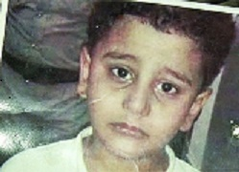
Child Found through
Social Media.
Tufail Esmail
A Pakistani boy who went missing from his home in Khyber Pakhtunkhwa province of Pakistan two years ago was found in India.
Tufail Esmail, who was five years old at the time, got separated from his family in June 2014 in Charsadda district.
The family searched for Esmail everywhere and registered a missing complaint with police the next day. Esmail’s family came to know that he was in Rajasthan when his maternal uncle in Saudi Arabia saw a picture on social media shared by an Indian social worker. The social worker had shared a contact number with the photo and requested social media users to share the post so the child could be reunited with his family.
Notes:
Social media helps to get child back to their parents

Slide 6
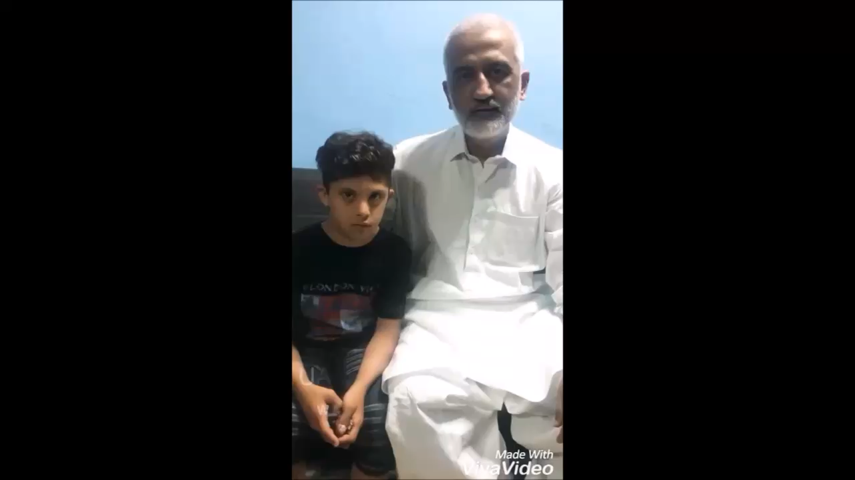
How we deal with this?
In Pakistan we use social media like
Facebook , twitter, YouTube etc for
Finding the missing one’s.
Notes:
We use social media, loudspeakers, newspaper and Television ads, posters and banners to help us find our loved ones.
Deliveroo, an online food ordering company also started a service to find missing children.
Around 500 of the food delivery app’s riders in London, Manchester, Birmingham
and Bristol displayed posters on the bags used to carry food as part of a campaign
with charity Missing People.
But it is limited to small geographical areas and has a very limited scope.

Slide 7

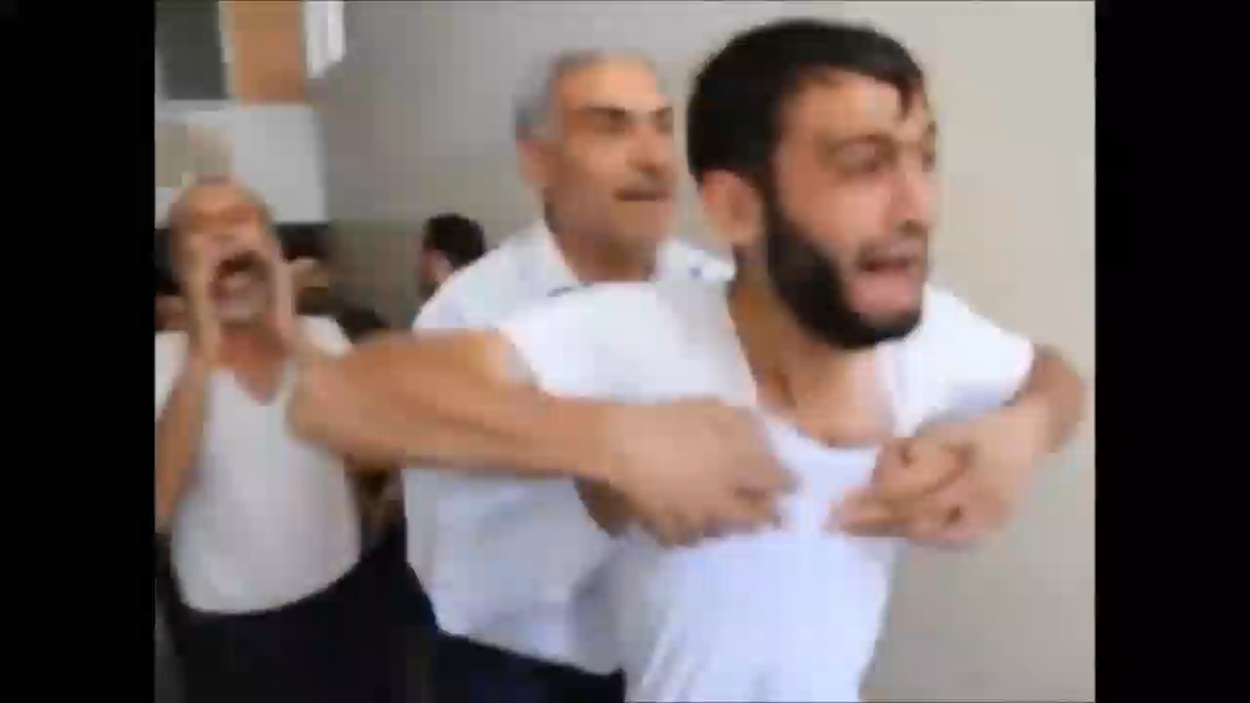
Help the one’s who matter the most.
Losing a kid.
Reuniting with a child.

Slide 8
Idea
Create a cross-platfrom application Using Artificial Intelligence and Deep Learning (One Shot Learning) to find missing children by using Face recognition and face matching technology.
Notes:
Idea is to use AI and Deep learning to find missing children
We create an app to help people to find missing one on the base of deep learning.

Slide 9
Solution
Azure Cognitive Services and Cloud technology
Cross-platform Deep Learning Based app to identify faces and match with faces in our database to find missing children. It is a cross-platform application to capture image of a child and match with database to check if the person is lost/found
Notes:
Parents/Relatives of missing children uploads an image of child with some details
and
if some other person find a lost child, he can upload pic of that child with location and contact details.
So
If it matches with someone in out database, parents of lost child gets a notification with location and contact details. And they can have their child back

Slide 10




Technology
Vision
Azure cognitive services for Vision(face detection and recognition) services.
Azure
Usage of azure Virtual Machine and GPU services for storage and processing.
TensorFlow
Usage of TensorFlow model trained on facenet for face detection and recognition
Kubernetes
Kubernetes is an open-source container system for automating application deployment, scaling, and management.

Slide 11
Features
Easy to Use
Cross-platform coverage
Applied AI & Deep Learning
Kubernetes scalable

Slide 12
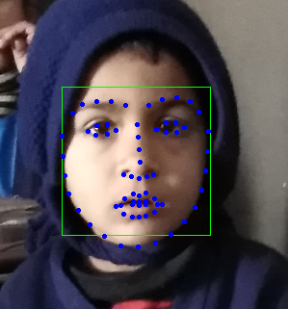
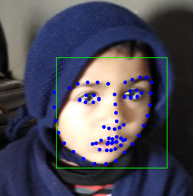
FaceNet and TensorFlow
Using facenet for face detection, recognition and comparing with other faces to find a person in database.
Facenet model is trained on Deep Learning libraries TensorFlow(Inception ResNet v1) for detection and comparing faces.
Match found

Slide 13

React Native
React native, a state-of-the art technology is used for cross-platform application development. We’ve created Android, iOS and web application using React Native and React for project Let’sFind.

Slide 14
Kubernetes orchestration
Dockerization is used in app for operating system level virtualization, portable containerization.
Docker makes it easy to create cross platform solution and all dependencies are packed inside single module
Build ship and run, any app, any where
Kubernetes is used for creating scalable docker containrs across multiple machines making them.
Kubernetes allows large number of containers to work
together. Dynamically scaling container on demand and
handling failovers.

Slide 15
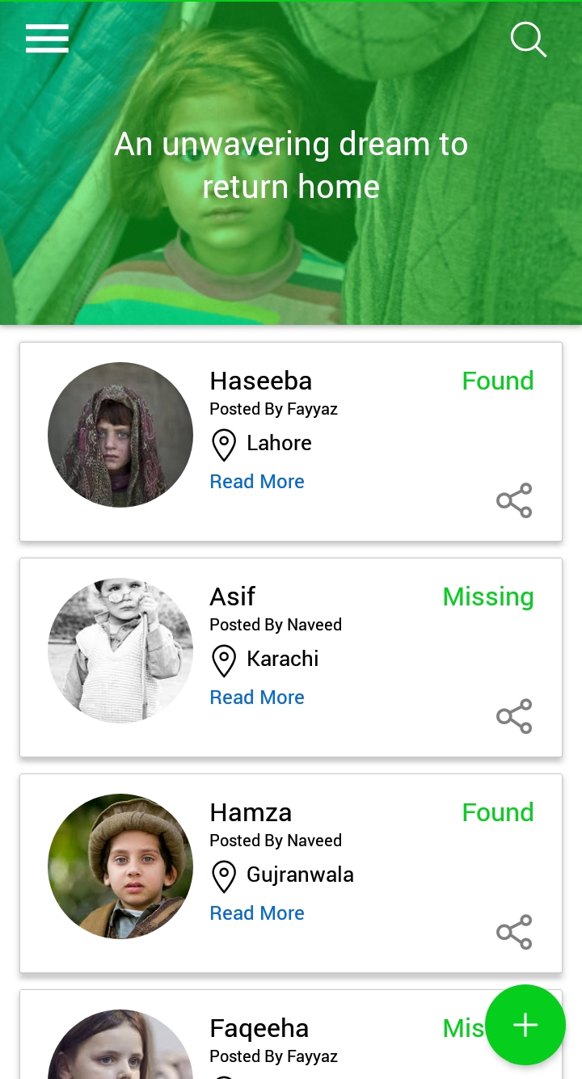
Mobile project
Place your screenshot here
Android mobile application for search and find missing children.

Slide 16
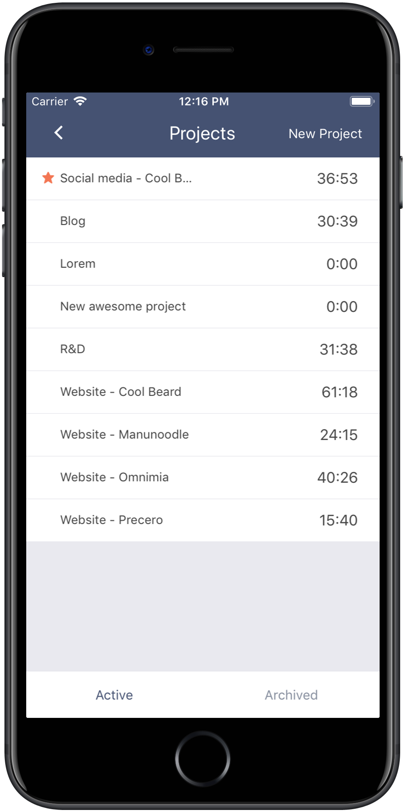
iOS project
Place your screenshot here
iOS mobile application for search and find missing children.

Slide 17
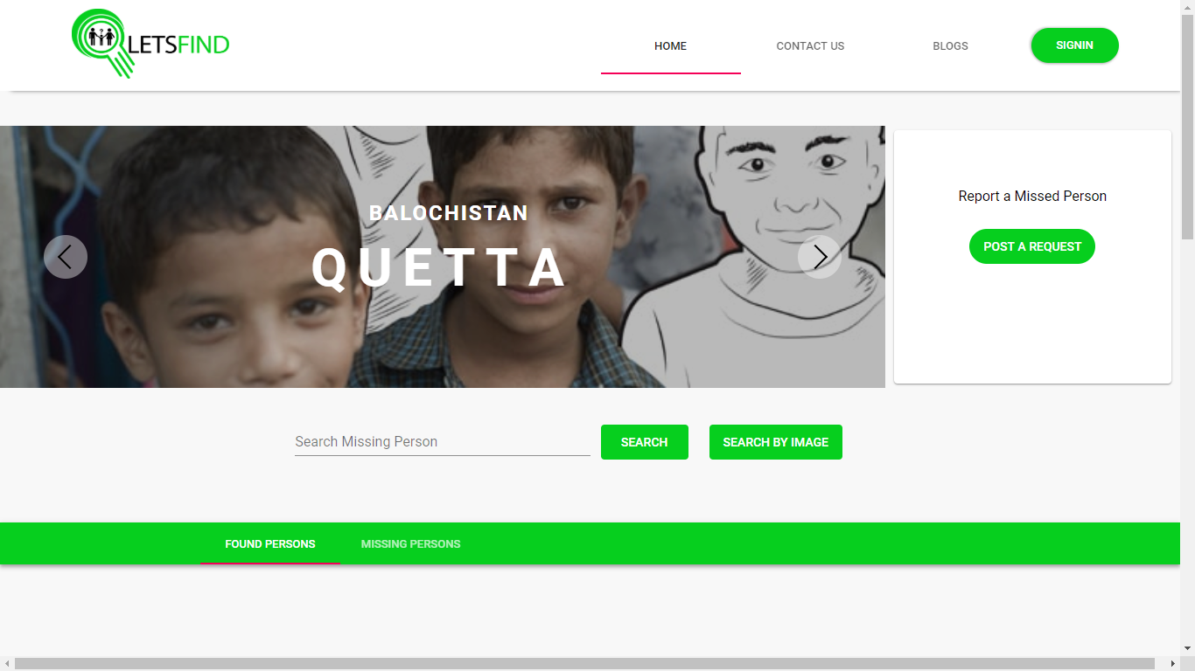
Desktop project
Place your screenshot here
Show and explain your web, app or software projects using these gadget templates.

Slide 18
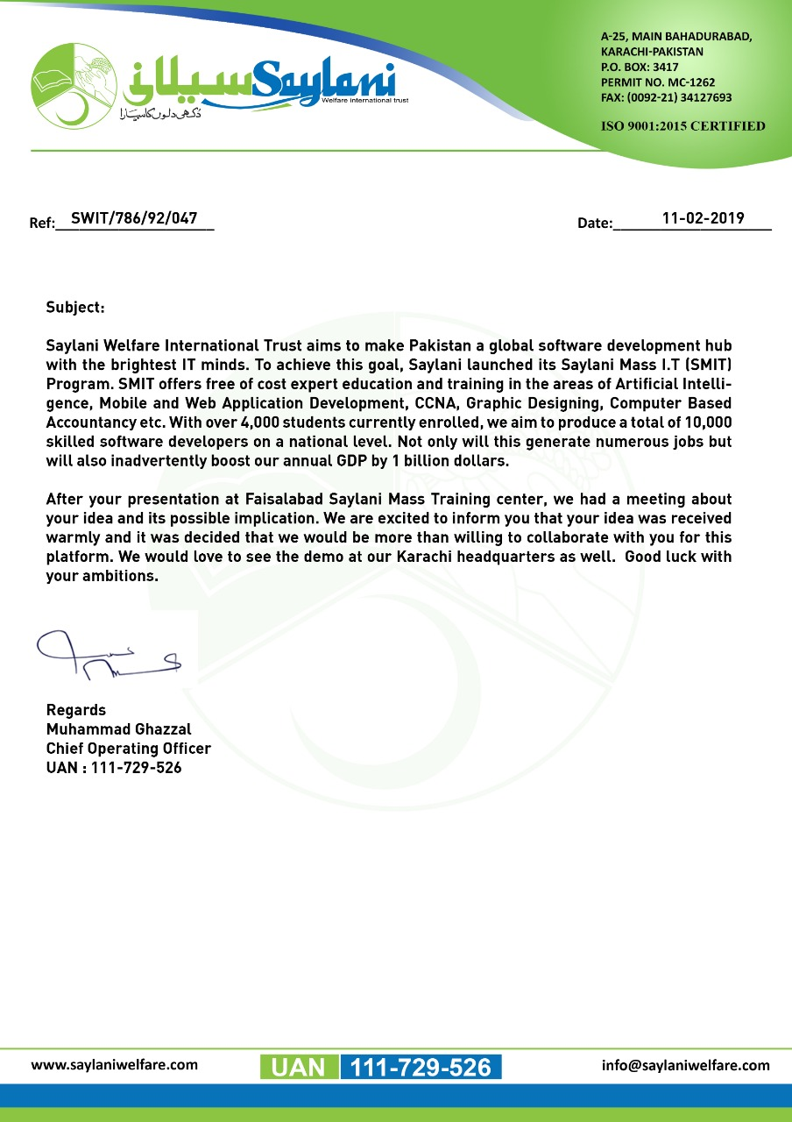
A strong working collaboration with NGOS.
(Salyani)

Slide 19
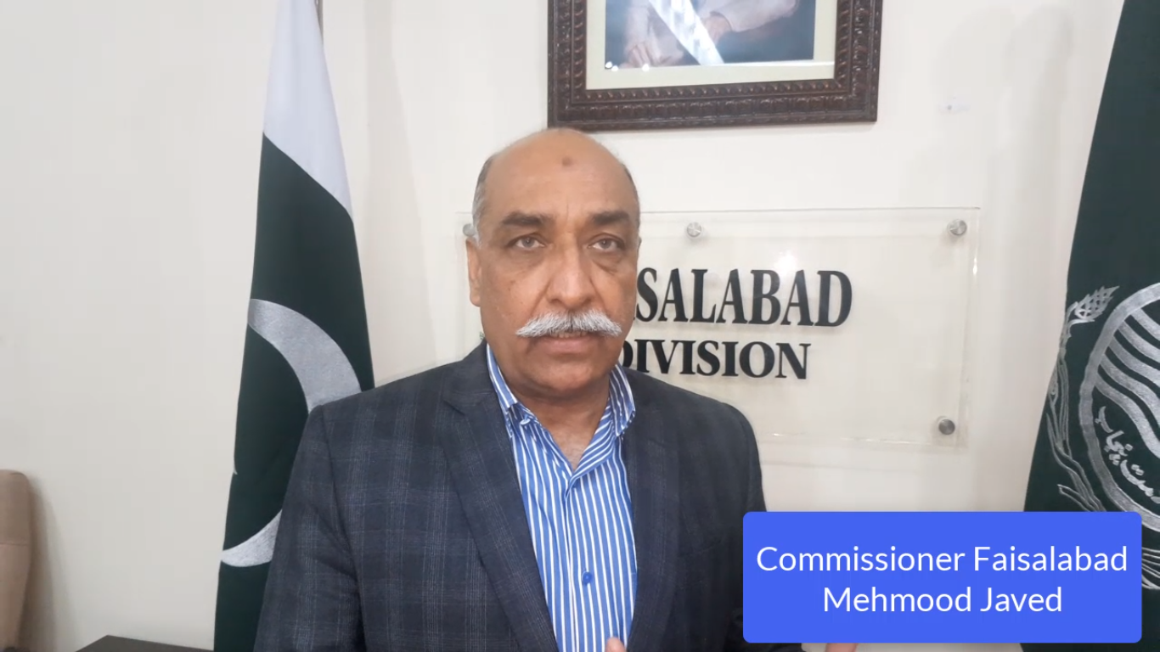
A strong working collaboration with NGOS.
(Salyani)

Slide 20
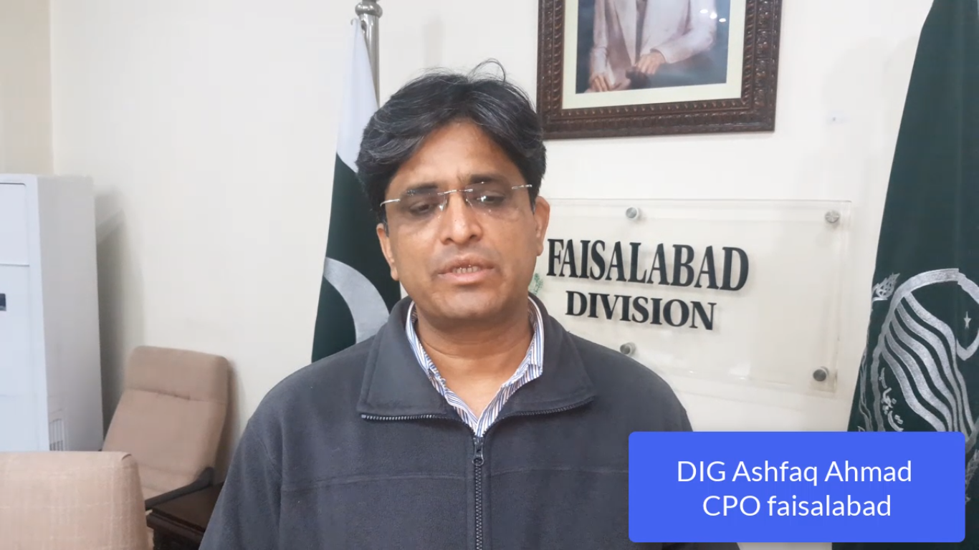
A strong working collaboration with NGOS.
(Salyani)

Slide 21
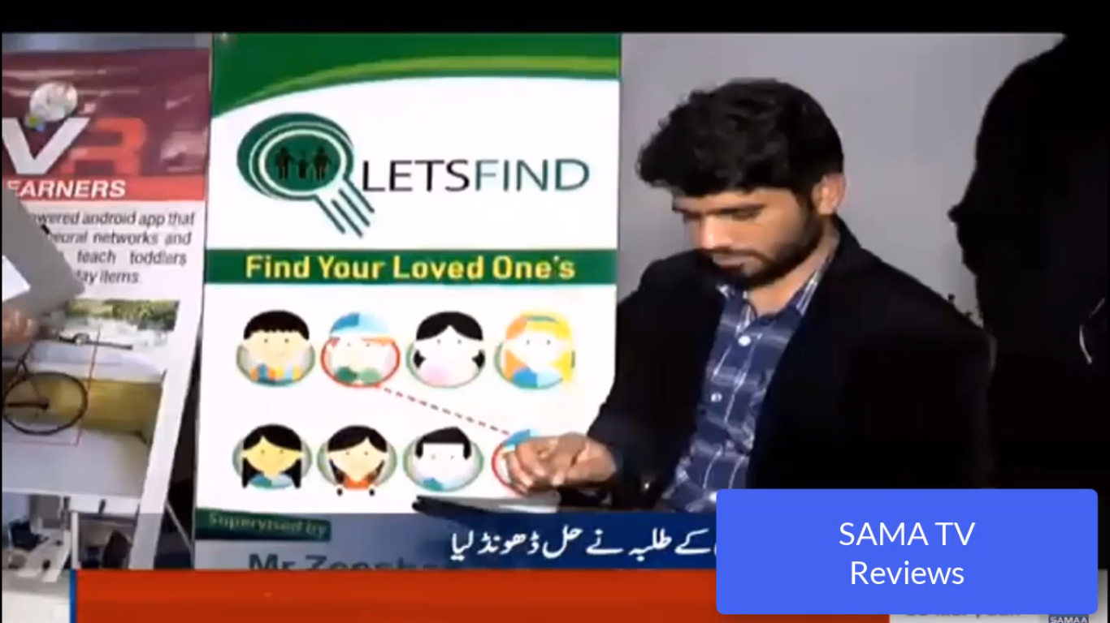
A strong working collaboration with NGOS.
(Salyani)

Slide 22
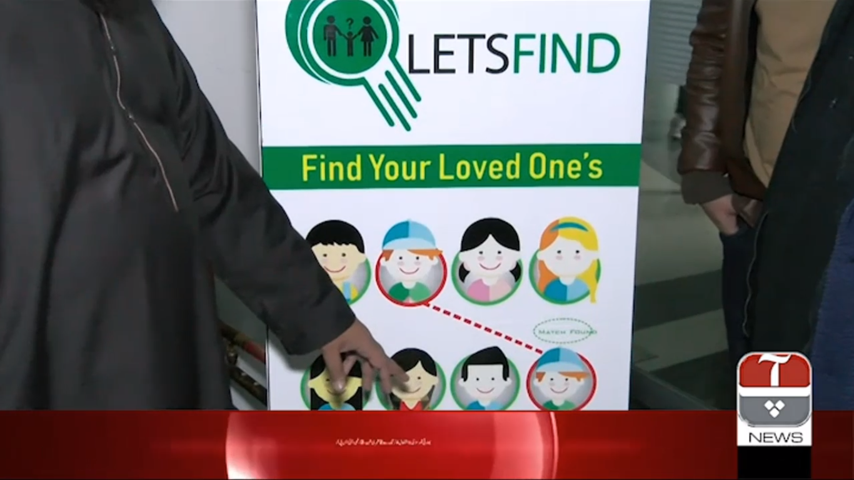
A strong working collaboration with NGOS.
(Salyani)

Slide 23
Thanks!
Any questions?
You can find me at:
@letsfind1

